Slide 1
UNIT IV
Mining Frequent Patterns, Association and Correlations
Prepared by : Dr. Lakshmi Priya GG

Slide 2
Introduction
Market Basket analysis,
Frequent Itemsets, Closed Itemsets, and Association Rules,
Frequent itemset mining methods: Apriori algorithm, partition algorithm, pincer-search algorithm. Dynamic itemset counting algorithm, FP growth,
Pattern- growth approach for mining frequent itemsets
Pattern Evaluation methods.

Slide 3
What Is Frequent Pattern Analysis?
Frequent pattern: a pattern (a set of items, subsequences, substructures, etc.) that occurs frequently in a data set
First proposed by Agrawal, Imielinski, and Swami [AIS93] in the context of frequent itemsets and association rule mining
Motivation: Finding inherent regularities in data
  What products were often purchased together?— Beer and diapers?!
  What are the subsequent purchases after buying a PC?
  What kinds of DNA are sensitive to this new drug?
  Can we automatically classify web documents?
Applications
  Basket data analysis, cross-marketing, catalog design, sale campaign analysis, Web log (click stream) analysis, and DNA sequence analysis.

Slide 4
Why Is Freq. Pattern Mining Important?
Discloses an intrinsic and important property of data sets
Forms the foundation for many essential data mining tasks
  Association, correlation, and causality analysis
  Sequential, structural (e.g., sub-graph) patterns
  Pattern analysis in spatiotemporal, multimedia, time-series, and stream data
  Classification: associative classification
  Cluster analysis: frequent pattern-based clustering
  Data warehousing: iceberg cube and cube-gradient
  Semantic data compression: fascicles
  Broad applications

Slide 5
Basic Concepts: Frequent Patterns and Association Rules
Transaction-id | Items bought
10 | A, B, D
20 | A, C, D
30 | A, D, E
40 | B, E, F
50 | B, C, D, E, F
Itemset X = {x₁, …, x_{k}}
Find all the rules X → Y with minimum support and confidence
  support, s, probability that a transaction contains X ∪ Y
  confidence, c, conditional probability that a transaction having X also contains Y
Customer
buys both
Customer
buys diaper
Let sup_{min} = 50%, conf_{min} = 50%
Freq. Pat.: {A:3, B:3, D:4, E:3, AD:3}
Association rules:
  A → D (60%, 100%)
  D → A (60%, 75%)
Customer
buys beer

Slide 6
Closed Patterns and Max-Patterns
A long pattern contains a combinatorial number of sub-patterns, e.g., {a₁, …, a₁₀₀} contains (₁₀₀¹) + (₁₀₀²) + … + (₁¹₀⁰₀⁰) = 2¹⁰⁰ – 1 = 1.27*10³⁰ sub-patterns!
Solution: Mine closed patterns and max-patterns instead
An itemset X is closed if X is frequent and there exists no super-pattern Y כ X, with the same support as X (proposed by Pasquier, et al. @ ICDT’99)
An itemset X is a max-pattern if X is frequent and there exists no frequent super-pattern Y כ X (proposed by Bayardo @ SIGMOD’98)
Closed pattern is a lossless compression of freq. patterns
  Reducing the # of patterns and rules

Slide 7
Closed Patterns and Max-Patterns
Exercise. DB = {<a₁, …, a₁₀₀>, < a₁, …, a₅₀>}
  Min_sup = 1.
What is the set of closed itemset?
  <a₁, …, a₁₀₀>: 1
  < a₁, …, a₅₀>: 2
What is the set of max-pattern?
  <a₁, …, a₁₀₀>: 1
What is the set of all patterns?
  !!

Slide 8
Association Rules Outline
Goal: Provide an overview of basic Association Rule mining techniques
Association Rules Problem Overview
  Large itemsets
Association Rules Algorithms
  Apriori
  Eclat

Slide 9
Example: Market Basket Data
Items frequently purchased together:
  Bread ⇒PeanutButter
Uses:
  Placement
  Advertising
  Sales
  Coupons
Objective: increase sales and reduce costs

Slide 10
Association Rule Definitions
Set of items: I={I₁,I₂,…,I_{m}}
Transactions: D={t₁,t₂, …, t_{n}}, t_{j}⊆ I
Itemset: {I_{i1},I_{i2}, …, I_{ik}} ⊆ I
Support of an itemset: Percentage of transactions which contain that itemset.
Large (Frequent) itemset: Itemset whose number of occurrences is above a threshold.

Slide 11
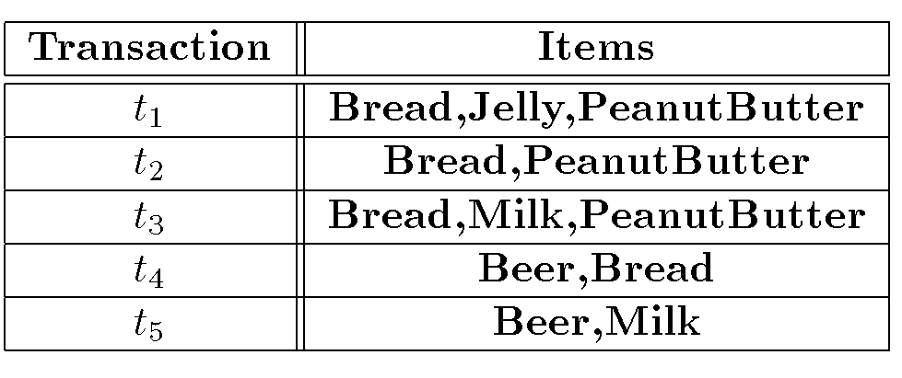
Association Rules Example
I = { Beer, Bread, Jelly, Milk, PeanutButter}
Support of {Bread,PeanutButter} is 60%

Slide 12
Association Rule Definitions
Association Rule (AR): implication X ⇒ Y where X,Y ⊆ I and X ∩ Y = ;
Support of AR (s) X ⇒ Y: Percentage of transactions that contain X ∪Y
Confidence of AR (α) X ⇒ Y: Ratio of number of transactions that contain X ∪ Y to the number that contain X

Slide 13
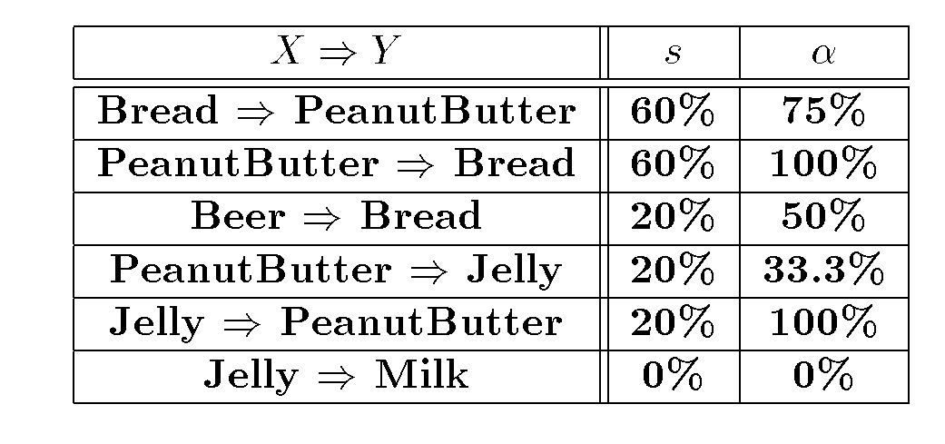
Association Rules Ex (cont’d)

Slide 14
Association Rule Problem
Given a set of items I={I₁,I₂,…,I_{m}} and a database of transactions D={t₁,t₂, …, t_{n}} where t_{i}={I_{i1},I_{i2}, …, I_{ik}} and I_{ij} ∈ I, the Association Rule Problem is to identify all association rules X ⇒ Y with a minimum support and confidence.
Link Analysis
NOTE: Support of X ⇒ Y is same as support of X ∪ Y.

Slide 15
Association Rule Techniques
Find Large Itemsets.
Generate rules from frequent itemsets.

Slide 16
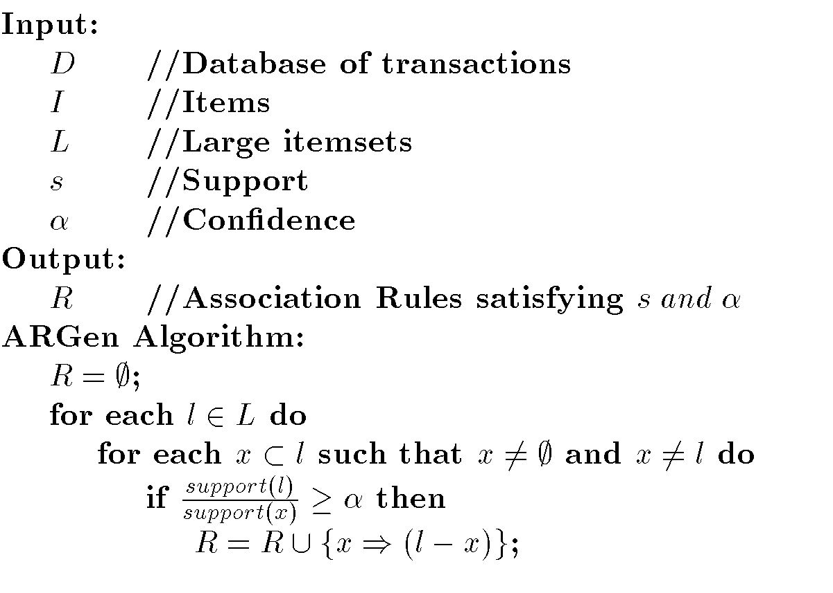
Algorithm to Generate ARs

Slide 17
Apriori
Large Itemset Property:
Any subset of a large itemset is large.
Contrapositive:
If an itemset is not large,
none of its supersets are large.

Slide 18
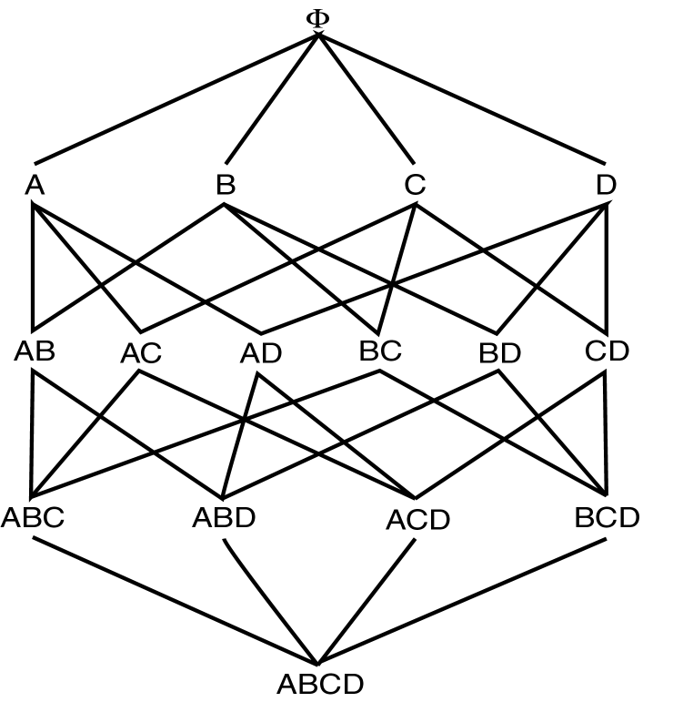
Large Itemset Property

Slide 19
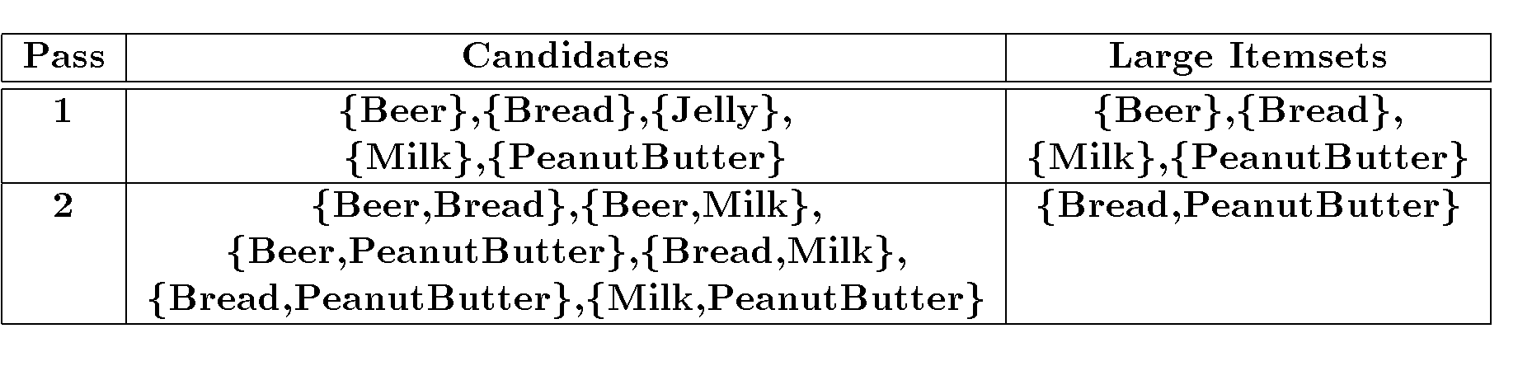
Apriori Ex (cont’d)
s=30% α = 50%

Slide 20
Apriori Algorithm
C₁ = Itemsets of size one in I;
Determine all large itemsets of size 1, L_{1;}
i = 1;
Repeat
i = i + 1;
C_{i} = Apriori-Gen(L_{i-1});
Count C_{i} to determine L_{i;}
until no more large itemsets found;

Slide 21
Apriori-Gen
Generate candidates of size i+1 from large itemsets of size i.
Approach used: join large itemsets of size i if they agree on i-1
May also prune candidates who have subsets that are not large.

Slide 22
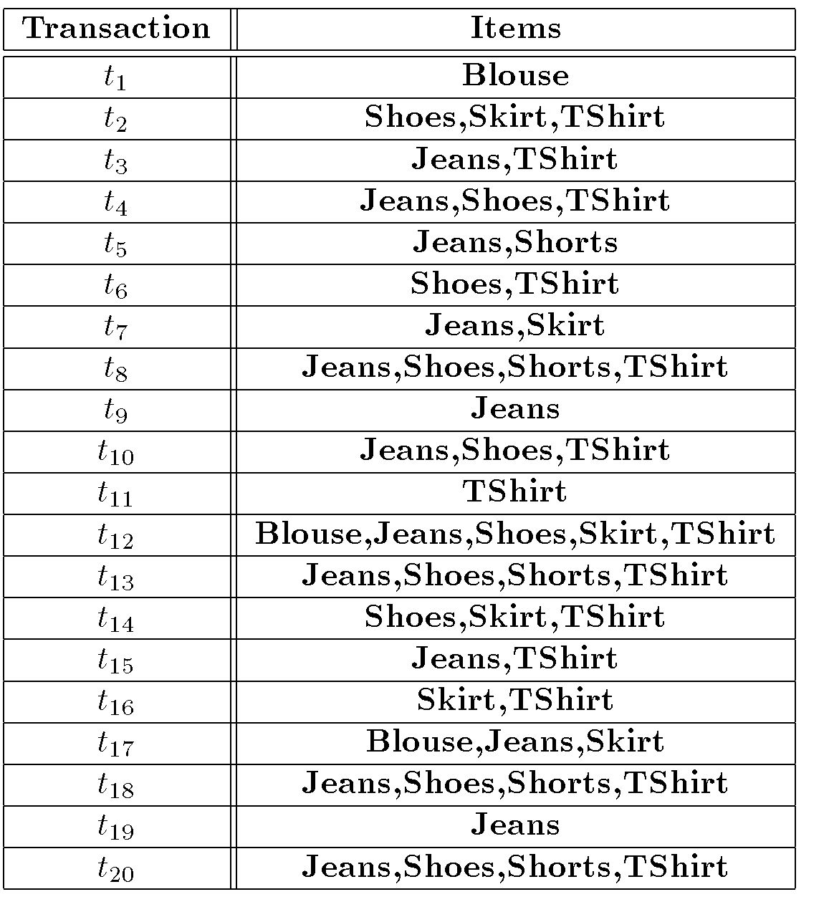
Apriori-Gen Example

Slide 23
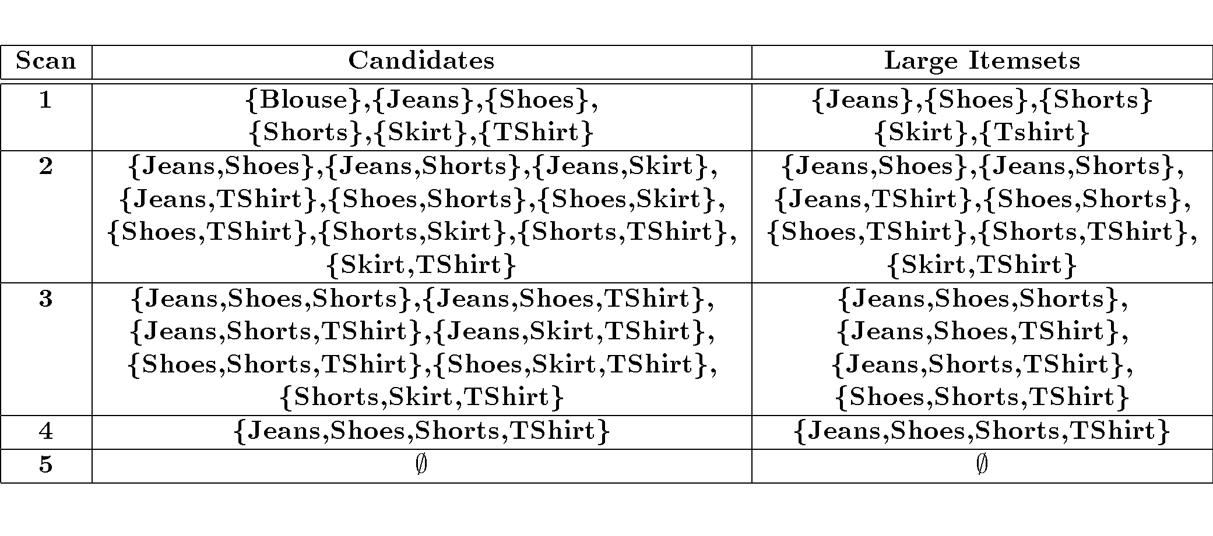
Apriori-Gen Example (cont’d)

Slide 24
Apriori Adv/Disadv
Advantages:
  Uses large itemset property.
  Easily parallelized
  Easy to implement.
Disadvantages:
  Assumes transaction database is memory resident.
  Requires up to m database scans.

Slide 25
Scalable Methods for Mining Frequent Patterns
The downward closure property of frequent patterns
  Any subset of a frequent itemset must be frequent
  If {beer, diaper, nuts} is frequent, so is {beer, diaper}
  i.e., every transaction having {beer, diaper, nuts} also contains {beer, diaper}
Scalable mining methods: Three major approaches
  Apriori (Agrawal & Srikant@VLDB’94)
  Freq. pattern growth (FPgrowth—Han, Pei & Yin @SIGMOD’00)
  Vertical data format approach (Charm—Zaki & Hsiao @SDM’02)

Slide 26
Apriori: A Candidate Generation-and-Test Approach
Apriori pruning principle: If there is any itemset which is infrequent, its superset should not be generated/tested! (Agrawal & Srikant @VLDB’94, Mannila, et al. @ KDD’ 94)
Method:
  Initially, scan DB once to get frequent 1-itemset
  Generate length (k+1) candidate itemsets from length k frequent itemsets
  Test the candidates against DB
  Terminate when no frequent or candidate set can be generated

Slide 27
The Apriori Algorithm—An Example
Sup_{min} = 2
Itemset | sup
{A} | 2
{B} | 3
{C} | 3
{D} | 1
{E} | 3
Database TDB
Itemset | sup
{A} | 2
{B} | 3
{C} | 3
{E} | 3
L₁
Tid | Items
10 | A, C, D
20 | B, C, E
30 | A, B, C, E
40 | B, E
C₁
1st scan
C₂
Itemset | sup
{A, B} | 1
{A, C} | 2
{A, E} | 1
{B, C} | 2
{B, E} | 3
{C, E} | 2
C₂
L₂
Itemset
{A, B}
{A, C}
{A, E}
{B, C}
{B, E}
{C, E}
Itemset | sup
{A, C} | 2
{B, C} | 2
{B, E} | 3
{C, E} | 2
2nd scan
C₃
Itemset
{B, C, E}
3rd scan
L₃
Itemset | sup
{B, C, E} | 2

Slide 28
The Apriori Algorithm
Pseudo-code:
    C_{k}: Candidate itemset of size k
    L_{k} : frequent itemset of size k
    L₁ = {frequent items};
    for (k = 1; L_{k} !=∅; k++) do begin
    C_{k+1} = candidates generated from L_{k};
    for each transaction t in database do
      increment the count of all candidates in C_{k+1} that are contained in t
    L_{k+1} = candidates in C_{k+1} with min_support
    end
    return ∪_{k} L_{k};

Slide 29
Important Details of Apriori
How to generate candidates?
  Step 1: self-joining L_{k}
  Step 2: pruning
How to count supports of candidates?
Example of Candidate-generation
  L₃={abc, abd, acd, ace, bcd}
  Self-joining: L₃*L₃
    abcd from abc and abd
    acde from acd and ace
  Pruning:
    acde is removed because ade is not in L₃
  C₄={abcd}

Slide 30
How to Generate Candidates?
Suppose the items in L_{k-1} are listed in an order
Step 1: self-joining L_{k-1}
  insert into C_{k}
  select p.item₁, p.item₂, …, p.item_{k-1}, q.item_{k-1}
  from L_{k-1} p, L_{k-1} q
  where p.item₁=q.item₁, …, p.item_{k-2}=q.item_{k-2}, p.item_{k-1} < q.item_{k-1}
Step 2: pruning
  forall itemsets c in C_{k} do
    forall (k-1)-subsets s of c do
      if (s is not in L_{k-1}) then delete c from C_{k}

Slide 31
How to Count Supports of Candidates?
Why counting supports of candidates a problem?
  The total number of candidates can be very huge
  One transaction may contain many candidates
Method:
  Candidate itemsets are stored in a hash-tree
  Leaf node of hash-tree contains a list of itemsets and counts
  Interior node contains a hash table
  Subset function: finds all the candidates contained in a transaction

Slide 32
Example: Counting Supports of Candidates
Subset function
Transaction: 1 2 3 5 6
3,6,9
1,4,7
2,5,8
1 + 2 3 5 6
1 3 + 5 6
2 3 4
5 6 7
1 4 5
3 4 5
3 5 6
3 5 7
6 8 9
3 6 7
3 6 8
1 3 6
1 2 + 3 5 6
1 2 4
4 5 7
1 2 5
4 5 8
1 5 9

Slide 33
Challenges of Frequent Pattern Mining
Challenges
  Multiple scans of transaction database
  Huge number of candidates
  Tedious workload of support counting for candidates
Improving Apriori: general ideas
  Reduce passes of transaction database scans
  Shrink number of candidates
  Facilitate support counting of candidates

Slide 34
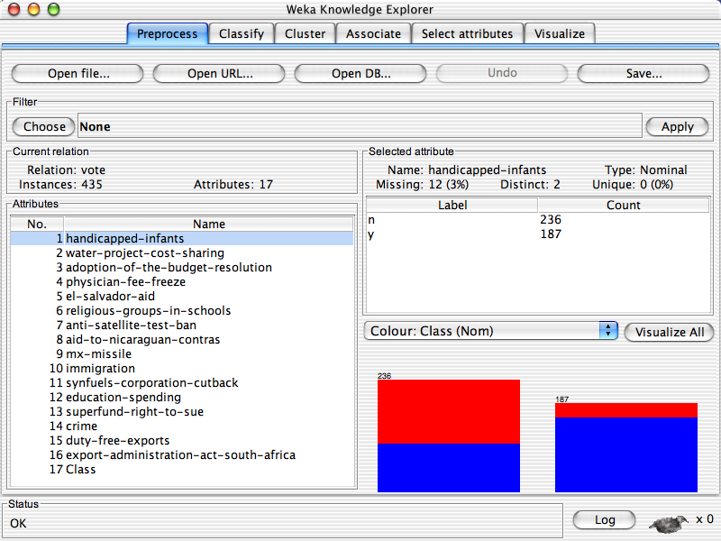
University of Waikato

Slide 35
University of Waikato

Slide 36
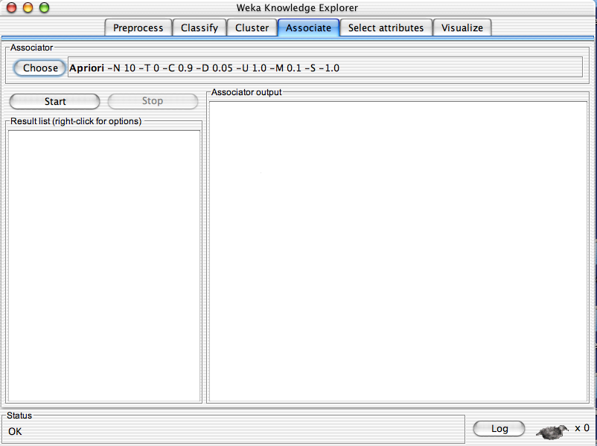
University of Waikato

Slide 37
University of Waikato

Slide 38
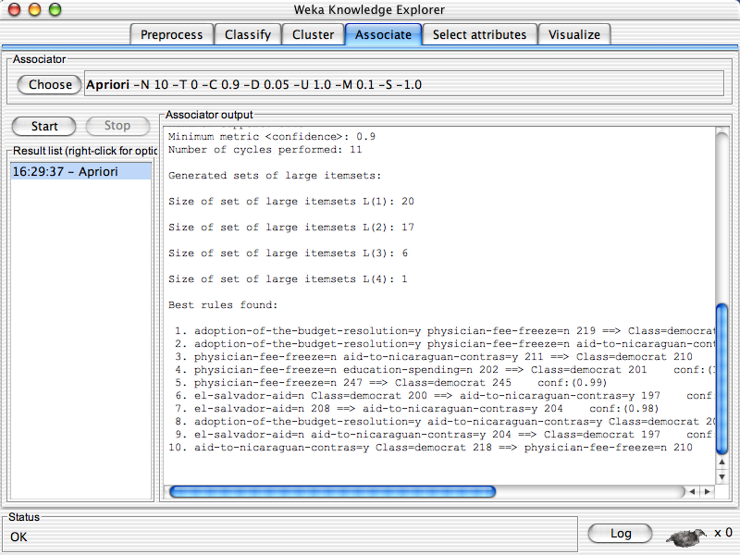
University of Waikato

Slide 39
Partition: Scan Database Only Twice
Any itemset that is potentially frequent in DB must be frequent in at least one of the partitions of DB
  Scan 1: partition database and find local frequent patterns
  Scan 2: consolidate global frequent patterns
A. Savasere, E. Omiecinski, and S. Navathe. An efficient algorithm for mining association in large databases. In VLDB’95

Slide 40
DHP: Reduce the Number of Candidates
A k-itemset whose corresponding hashing bucket count is below the threshold cannot be frequent
  Candidates: a, b, c, d, e
  Hash entries: {ab, ad, ae} {bd, be, de} …
  Frequent 1-itemset: a, b, d, e
  ab is not a candidate 2-itemset if the sum of count of {ab, ad, ae} is below support threshold
J. Park, M. Chen, and P. Yu. An effective hash-based algorithm for mining association rules. In SIGMOD’95

Slide 41
Sampling for Frequent Patterns
Select a sample of original database, mine frequent patterns within sample using Apriori
Scan database once to verify frequent itemsets found in sample, only borders of closure of frequent patterns are checked
  Example: check abcd instead of ab, ac, …, etc.
Scan database again to find missed frequent patterns
H. Toivonen. Sampling large databases for association rules. In VLDB’96

Slide 42
DIC: Reduce Number of Scans
ABCD
Once both A and D are determined frequent, the counting of AD begins
Once all length-2 subsets of BCD are determined frequent, the counting of BCD begins
ABC
ABD
ACD
BCD
AB
AC
BC
AD
BD
CD
Transactions
1-itemsets
A
B
C
D
Apriori
2-itemsets
…
{}
Itemset lattice
1-itemsets
S. Brin R. Motwani, J. Ullman, and S. Tsur. Dynamic itemset counting and implication rules for market basket data. In SIGMOD’97
2-items
DIC
3-items

Slide 43
Bottleneck of Frequent-pattern Mining
Multiple database scans are costly
Mining long patterns needs many passes of scanning and generates lots of candidates
  To find frequent itemset i₁i₂…i₁₀₀
    # of scans: 100
    # of Candidates: (₁₀₀¹) + (₁₀₀²) + … + (₁¹₀⁰₀⁰) = 2¹⁰⁰-1 = 1.27*10³⁰ !
Bottleneck: candidate-generation-and-test
Can we avoid candidate generation?

Slide 44
Mining Frequent Patterns Without Candidate Generation
Grow long patterns from short ones using local frequent items
  “abc” is a frequent pattern
  Get all transactions having “abc”: DB|abc
  “d” is a local frequent item in DB|abc → abcd is a frequent pattern

Slide 45
Construct FP-tree from a Transaction Database
TID Items bought (ordered) frequent items
100 {f, a, c, d, g, i, m, p} {f, c, a, m, p}
200 {a, b, c, f, l, m, o} {f, c, a, b, m}
300 {b, f, h, j, o, w} {f, b}
400 {b, c, k, s, p} {c, b, p}
500 {a, f, c, e, l, p, m, n} {f, c, a, m, p}
min_support = 3
{}
Header Table
Item frequency head
f 4
c 4
a 3
b 3
m 3
p 3
Scan DB once, find frequent 1-itemset (single item pattern)
Sort frequent items in frequency descending order, f-list
Scan DB again, construct FP-tree
f:4
c:1
c:3
b:1
b:1
a:3
p:1
m:2
b:1
F-list=f-c-a-b-m-p
p:2
m:1

Slide 46
Benefits of the FP-tree Structure
Completeness
  Preserve complete information for frequent pattern mining
  Never break a long pattern of any transaction
Compactness
  Reduce irrelevant info—infrequent items are gone
  Items in frequency descending order: the more frequently occurring, the more likely to be shared
  Never be larger than the original database (not count node-links and the count field)
  For Connect-4 DB, compression ratio could be over 100

Slide 47
Algorithms to find frequent pattern
Apriori: uses a generate-and-test approach – generates candidate itemsets and tests if they are frequent
  Generation of candidate itemsets is expensive (in both space and time)
  Support counting is expensive
    Subset checking (computationally expensive)
    Multiple Database scans (I/O)
FP-Growth: allows frequent itemset discovery without candidate generation. Two step:
  1.Build a compact data structure called the FP-tree
    2 passes over the database
  2.extracts frequent itemsets directly from the FP-tree
    Traverse through FP-tree

Slide 48
Pattern-Growth Approach: Mining Frequent Patterns Without Candidate Generation
The FP-Growth Approach
  Depth-first search (Apriori: Breadth-first search)
  Avoid explicit candidate generation
FP-Growth approach:
For each frequent item, construct its conditional pattern-base, and then its conditional FP-tree
Repeat the process on each newly created conditional FP-tree
Until the resulting FP-tree is empty, or it contains only one path—single path will generate all the combinations of its sub-paths, each of which is a frequent pattern
Fp-tree construatioin:
Scan DB once, find frequent 1-itemset (single item pattern)
Sort frequent items in frequency descending order, f-list
Scan DB again, construct FP-tree

Slide 49
FP-tree Size
The size of an FP­tree is typically smaller than the size of the uncompressed data because many transactions often share a few items in common
  Best­case scenario: All transactions have the same set of items, and the FP­tree contains only a single branch of nodes.
  Worst­case scenario: Every transaction has a unique set of items. As none of the transactions have any items in common, the size of the FP­tree is effectively the same as the size of the original data.
The size of an FP­tree also depends on how the items are ordered

Slide 50
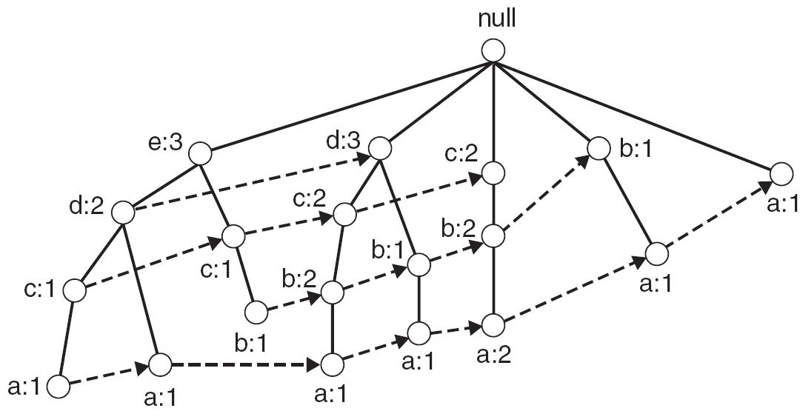
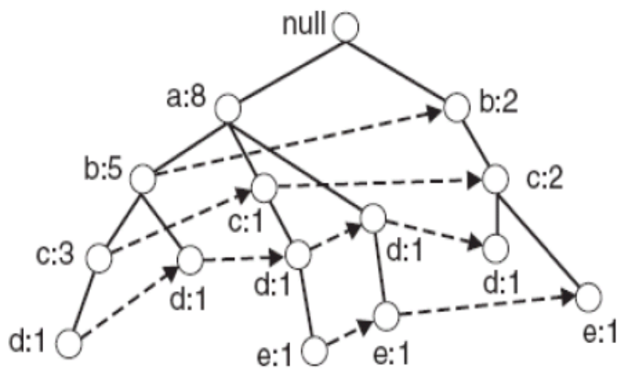
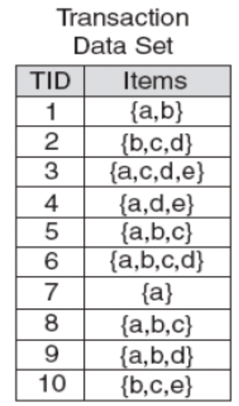
Example
FP-tree with item descending ordering
FP-tree with item ascending ordering

Slide 51
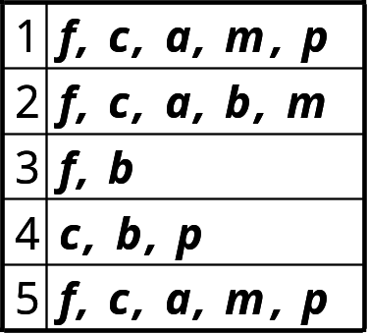
Find Patterns Having p From P-conditional Database
Start at the frequent item header table in the FP-tree
Traverse the FP-tree by following the link of each frequent item p
Accumulate all of transformed prefix paths of item p to form p’s conditional pattern base
{}
Conditional pattern bases
item cond. pattern base
c f:3
a fc:3
b fca:1, f:1, c:1
m fca:2, fcab:1
p fcam:2, cb:1
Header Table
Item frequency head
f 4
c 4
a 3
b 3
m 3
p 3
f:4
c:1
c:3
b:1
b:1
a:3
p:1
m:2
b:1
p:2
m:1

Slide 52
{}
{}
f:2
c:1
f:3
c:2
b:1
c:3
{}
a:2
p:1
a:3
f:4
c:1
+ p
b:1
+ m
m:2
c:3
b:1
b:1
(1)
(2)
a:3
p:1
{}
{}
{}
m:2
b:1
f:2
c:1
f:3
f:4
f:3
p:2
m:1
c:1
c:3
+ c
+ a
+ b
a:1
(3)
(4)
(5)
(6)

Slide 53
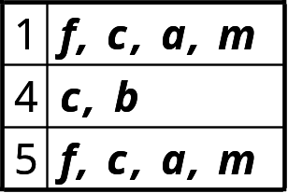
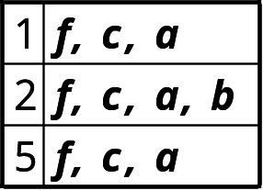
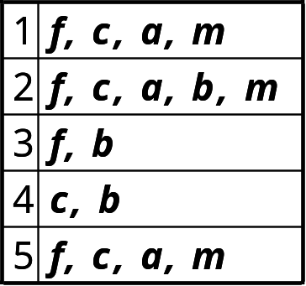
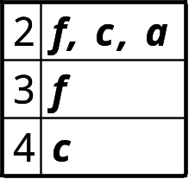
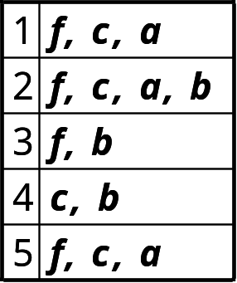
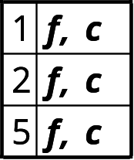
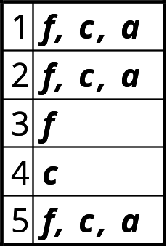
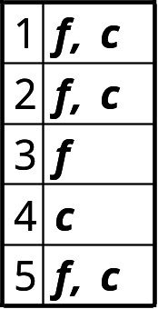
FP-Growth
+ p
+ m
+ b
+ a

Slide 54
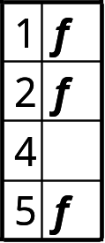
FP-Growth
+ p
+ m
(1)
(2)
+ b
+ a
(3)
(4)
+ c
f: 1,2,3,5
(6)
(5)

Slide 55
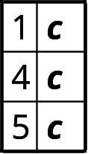
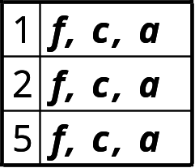
+ p
p: 3
cp: 3
+ p
+ m
m: 3
fm: 3
cm: 3
am: 3
fcm: 3
fam: 3
cam: 3
fcam: 3
min_sup = 3
+ m
+ b
b: 3
a: 3
fa: 3
ca: 3
fca: 3
+ a
c: 4
fc: 3
+ c
f: 1,2,3,5
f: 4

Slide 56
Which Patterns Are Interesting?—Pattern Evaluation Methods

Slide 57
Are All the “Discovered” Patterns Interesting?
Data mining may generate thousands of patterns: Not all of them are interesting
  Suggested approach: Human-centered, query-based, focused mining
Interestingness measures
  A pattern is interesting if it is easily understood by humans, valid on new or test data with some degree of certainty, potentially useful, novel, or validates some hypothesis that a user seeks to confirm
Objective vs. subjective interestingness measures
  Objective: based on statistics and structures of patterns, e.g., support, confidence, etc.
  Subjective: based on user’s belief in the data, e.g., unexpectedness, novelty, actionability, etc.
Data Mining: Concepts and Techniques

Slide 58
Find All and Only Interesting Patterns?
Find all the interesting patterns: Completeness
  Can a data mining system find all the interesting patterns? Do we need to find all of the interesting patterns?
  Heuristic vs. exhaustive search
  Association vs. classification vs. clustering
Search for only interesting patterns: An optimization problem
  Can a data mining system find only the interesting patterns?
  Approaches
    First general all the patterns and then filter out the uninteresting ones
    Generate only the interesting patterns—mining query optimization
Data Mining: Concepts and Techniques

Slide 59



Interestingness Measure: Correlations (Lift)
play basketball ⇒ eat cereal [40%, 66.7%] is misleading
  The overall % of students eating cereal is 75% > 66.7%.
play basketball ⇒ not eat cereal [20%, 33.3%] is more accurate, although with lower support and confidence
Measure of dependent/correlated events: lift
 | Basketball | Not basketball | Sum (row)
Cereal | 2000 | 1750 | 3750
Not cereal | 1000 | 250 | 1250
Sum(col.) | 3000 | 2000 | 5000

Slide 60

Are lift and χ² Good Measures of Correlation?
“Buy walnuts ⇒ buy milk [1%, 80%]” is misleading if 85% of customers buy milk
Support and confidence are not good to indicate correlations
Over 20 interestingness measures have been proposed (see Tan, Kumar, Sritastava @KDD’02)
Which are good ones?

